Slide 1



COMMUNITY ENERGY PLAN
FOR CITY OF PLAINFIELD

Slide 2
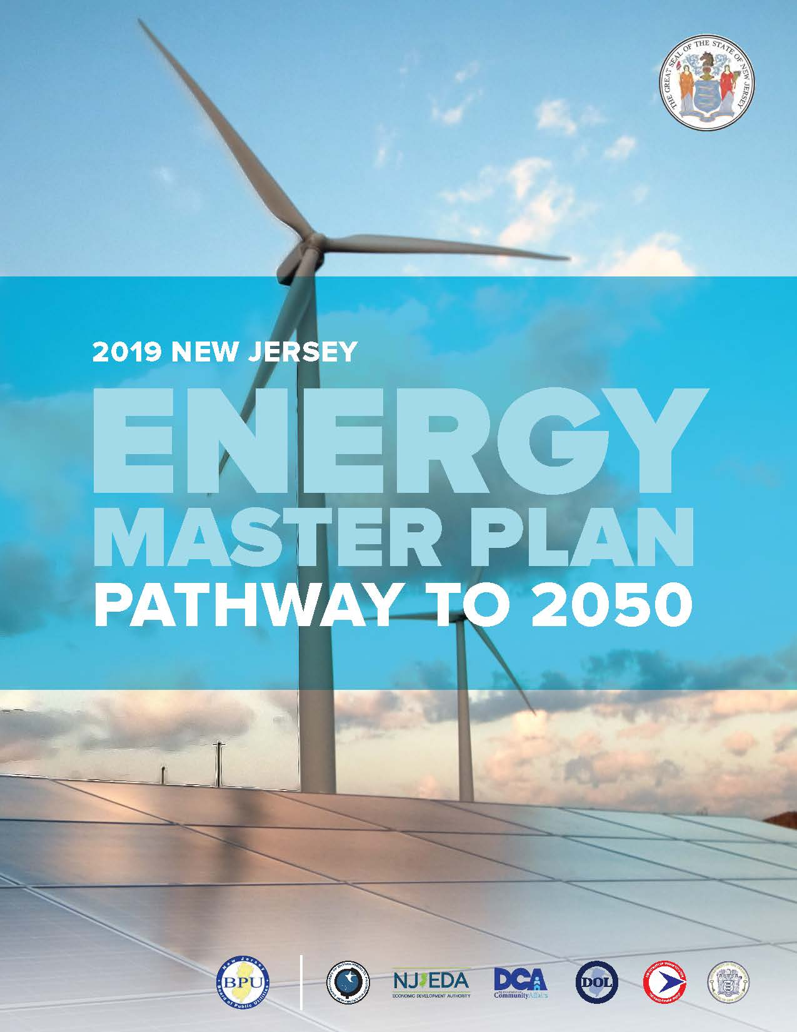
BACKGROUND
2019 New Jersey Energy Master Plan:
  100% Clean Energy, 80% ’06 emissions by 2050
  Buildings, vehicles, utilities
2021: NJBPU Launches Community Energy Plan Grant Program
  Plainfield received a $25,000 grant
  Sustainable Jersey provides expertise and technical support
  Help municipalities plan to increase energy efficiency
  Expand renewable energy generation
  Promote vehicle electrification
Community Energy Plan Document: Plan
  3 to 5 year implementation
Policy guidance document
  Not a Master Plan Element

Slide 3
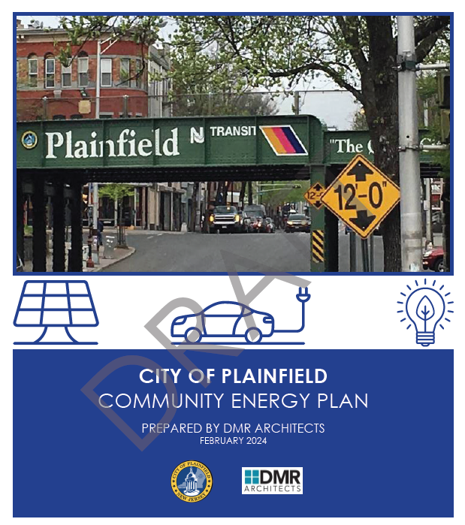
PURPOSE
Promote and adopt cleaner and less expensive energy sources
Advance the objectives of the NJ Energy Master Plan
Plan includes 23 initiatives including:
  Electrifying municipal fleet vehicles
  Installing public EV charging stations
  Zoning to permit private and community solar
  Installing on-site renewable energy systems with storage capabilities
  Promote alternative modes of travel within City
  Encourage implementation of green building practices
  Education for reduction of energy usage
  Ensuring low and moderate income households benefit

Slide 4
STRATEGY AREAS
Energy use from the transportation sector
Expand renewable energy generation
Improve energy efficiency of existing buildings
Promote energy efficient practices in the building sector
Make community energy accessible to Low and Moderate Income populations
Expand the innovation economy

Slide 5
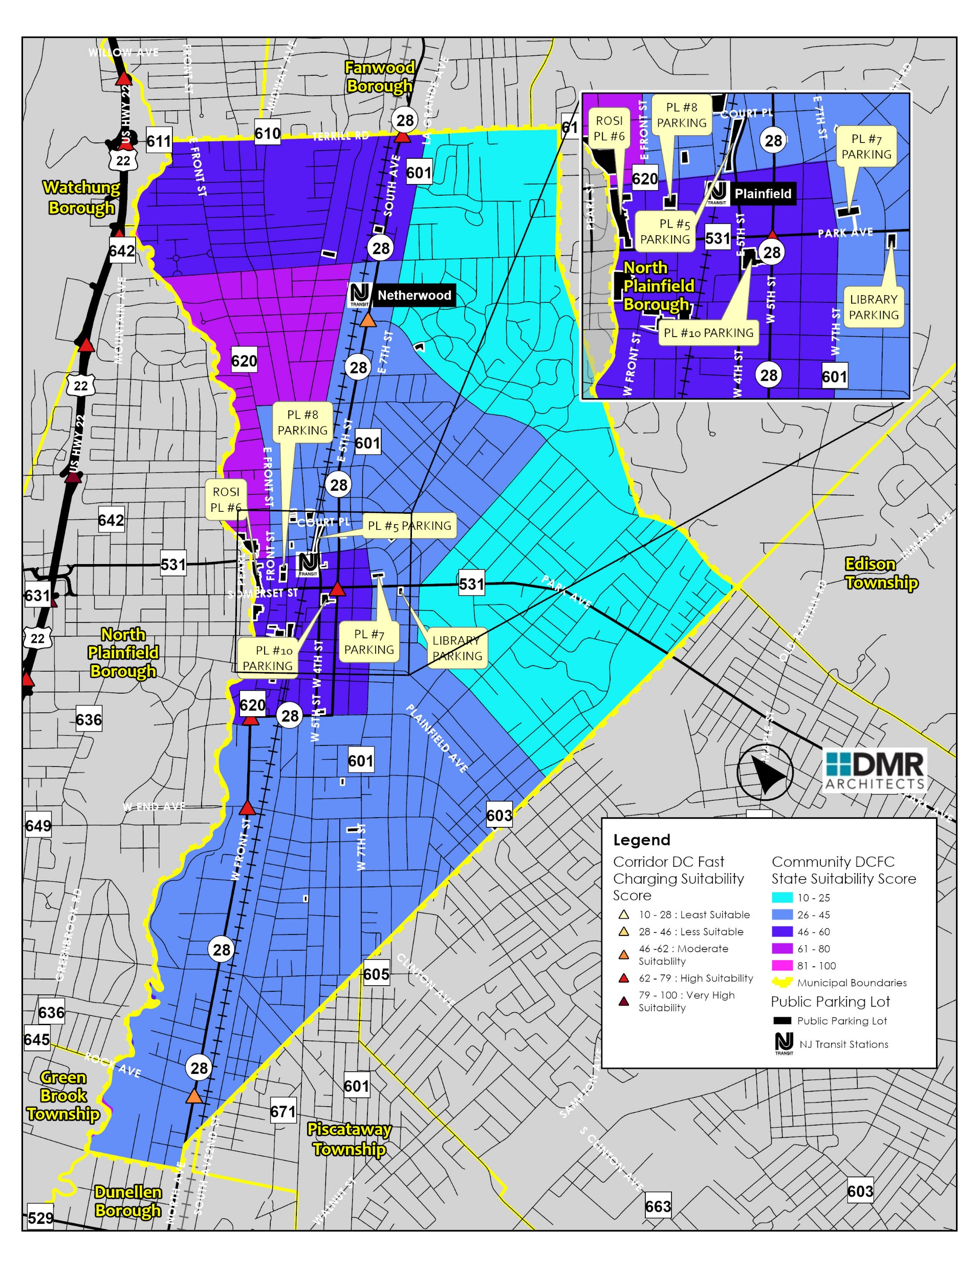
INITIATIVES
Zoning, regulations, and permitting process for electric vehicle charging, renewable energy, and battery storage
Creating a public EV charger network
Electrifying fleet
Training staff on EVs, solar
Improving municipal building efficiency
Education/outreach to residents and businesses
  Incentive and assistance programs
  Green building practices
  Energy management practices
  Benefits of workplace EV charging
Green building checklist requirement

Slide 6
NEXT STEPS
Implementation funding
  Apply for grants from BPU for up to $500,000 per municipality
Establish a Green Team
  Diverse body to implement energy plan
Commercial focus on energy usage will have greatest impact
  Engage employers, property owners
Outreach and education to public, community groups
Take advantage of financial incentives
  Grants, tax credits, no-interest loans
  Municipal, residents, businesses
Energy improvements pay-off
  Lower energy costs, incentives, renewable energy credits

Slide 7
THANK YOU
Dan Hauben, AICP – PP – LEED Green Associate
Senior Project Planner

